Slide 1

GOVERNMENT COLLEGE OF ENGINEERING BARGur (AUTONOMOUS)
PROJECT TITLE: Image recognition with IBM Cloud visual recognition.
TEAM MEMBERS:
Swetha.S
Sruthi.M.P
Kiruthika.P
Jenifer Sugnathi.S
Latha Mangeskar.M.S

Slide 2
PROBLEM STATEMENT:
Design and implement an image recognition system capable of accurately identifying and categorizing objects classification system that accurately identifies and categorizes images of animals into one of ten predefined classes. The goal is to develop a deep learning model that can distinguish between various animals, including dogs, horses, elephants, butterflies, chickens, cats, cows, sheep, spiders, and squirrels. This system will be able to handle single images as well as batches of test images, providing predictions with associated animal labels. The model should be trained to achieve a high level of accuracy in recognizing and classifying animal images.

Slide 3
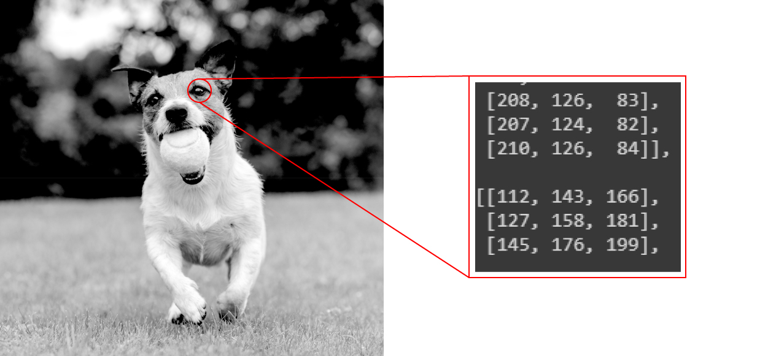
Image recognition:
Image recognition refers to technologies that identify places, logos, people, objects, buildings, and several other variables in digital images. It may be very easy for humans like you and me to recognise different images, such as images of animals.
We can easily recognise the image of a cat and differentiate it from an image of a horse. But it may not be so simple for a computer.

Slide 4
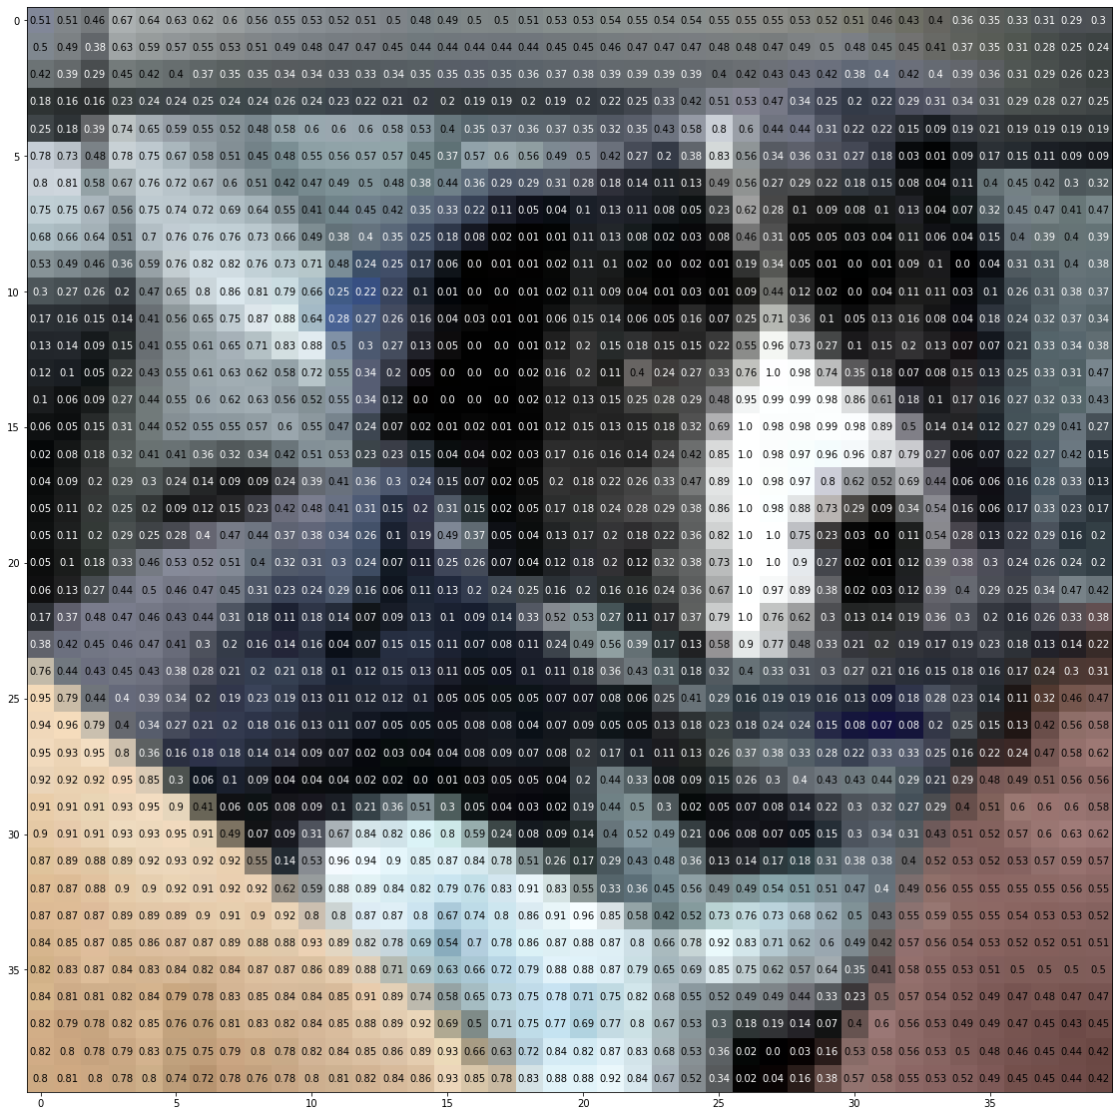
Image recognition:
An image of a dog represented by 40 x 40 pixels.

Slide 5
Working of Image Recognition:
We need a dataset containing images with their respective labels. For example, an image of a dog must be labelled as a dog or something that we can understand.
Next, these images are to be fed into a Neural Network and then trained on them. Usually, for the tasks concerned with images, we use convolutional neural network. These networks consist of convolutional layers and pooling layers in addition to Multilayer perceptron(MLP).
We feed in the image that is not in the training set and get predictions.

Slide 6
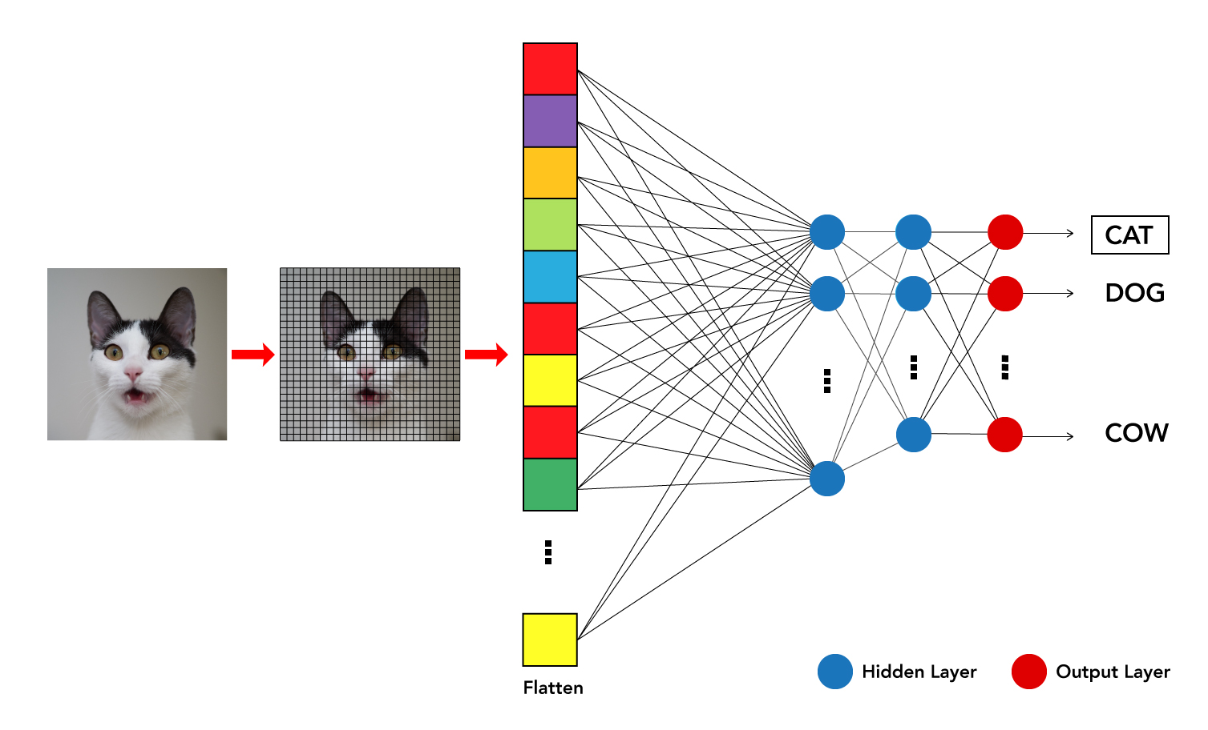
Working of Image Recognition:
For example, a model trained to recognise dogs and cat cannot recognise boats.

Slide 7
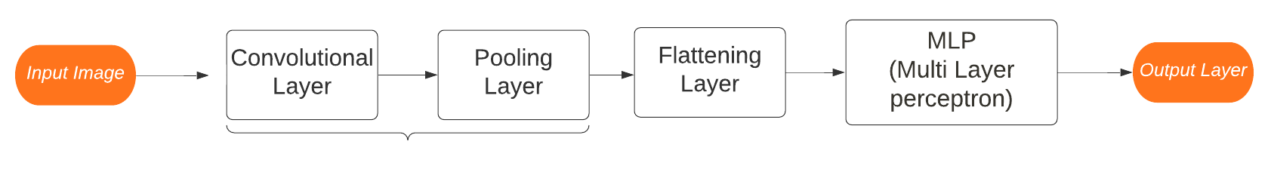
Working of Image Recognition in python:
Image recognition in python gives an input image to a Neural network (the most popular neural network used for image recognition is Convolution Neural Network). The task is split mainly into two categories:
1. Classification of the image to a single category /multiple categories.
2. Identification of certain objects in an Image ( This can be done only for the purpose of detection, segmentation, object tracking in videos, etc..)

Slide 8
Convolutional layer:
Purpose: Detect certain features in the image.
Operation: The convolution of Input Image and feature detector (or filter) is used to detect certain features in the image. Convolution occurs in the same manner as digital signal processing. Convolution occurs in the same manner as digital signal processing.
Output:
The output of this layer is called a feature map. The size of the feature map is less than the size of the image.
This has the advantage of making the computation process easier. A point to elaborate is that part of image information is lost due to decreased output size.
However, this doesn’t cause a problem because the feature map’s values are different from the original image as they represent the locations where the highest detection of the filter is performed.

Slide 9
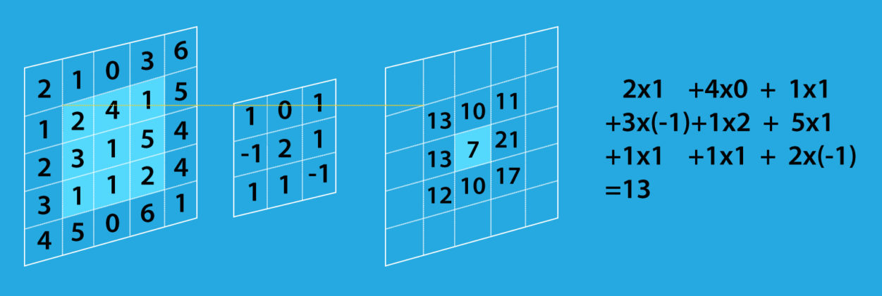
Working of Convolutional Layers:
The convolutional layer’s parameters consist of a set of learnable filters (or kernels), which have a small receptive field. These filters scan through image pixels and gather information in the batch of pictures/photos. Convolutional layers convolve the input and pass its result to the next layer.

Slide 10
Relu Rectifier:
Purpose:
Increase non-linearity of images so they can be easily separable.
Normally, images are highly non-linear because there are many details related to intensity, borders, etc.
The convolutional layer can result in linear feature maps, so this step is highly crucial.
Operation:
A relu rectifier is applied to the feature map
Output:
The output of this layer is a feature map with higher non-linearity.

Slide 11
Maximum Pooling layer:
Purpose: Distinguish features if they are distorted. The main purpose is to detect features even if there is a slight difference in the feature itself.
Operation:
Maximum pooling finds the maximum value of a certain window.
The maximum pooling Layer shifts to the left by a certain number of steps called strides.
Output:
Output of this layer is pooled feature map. Pooled feature map has multiple advantages. The output size is always smaller.
Maximum values are still present, and these are the locations of highest similarity with the featured filter. In addition, more than 75% of image information that isn’t related to features or is useless are removed.
In addition, the Feature map becomes prominent to distortion if the feature value is shifted from its location.

Slide 12
Flattening and Fully Connected Layer:
Flattening:
Numbers are taken row by row, column by column and put in a single column.
The main purpose of this step is to convert matrix output from the previous layer to a format that can be accepted by ANN.
Fully Connected Layer
This is an artificial neural network where input is the flattened layer, followed by a group of fully connected layers—finally, the output layer according to categories that we have or objects that need to be detected.

Slide 13
Import libraries:
import tensorflow as tf
from tensorflow.keras.preprocessing.image import ImageDataGenerator
Data Preprocessing:
train_datagen = ImageDataGenerator( rescale =1./255, zoom_range = 0.2, horizontal_flip = True)
training_set = train_datagen.flow_from_directory('link to dataset directory',target_size = (64, 64),
batch_size = 32,class_mode = 'binary')

Slide 14
Model definition and training:
Initialize an instance of the class
cnn = tf.keras.models.Sequential()
2.Initialize convolutional Network
Build Initial convolutional layer of CNN with an input shape corresponding to target image output. Note that filter and kernel size varies accordingly.
cnn.add(tf.keras.layers.Conv2D(filters=5, kernel_size=3, activation='relu', input_shape=[64, 64, 3])))
Add Maximum pooling layer, where pool size and strides can vary accordingly.
cnn.add(tf.keras.layers.MaxPool2D(pool_size=2, strides=2))
Add Convolutional + Maximum pooling layer according to required network architecture.
cnn.add(tf.keras.layers.Conv2D(filters=32, kernel_size=3, activation='relu'))
cnn.add(tf.keras.layers.MaxPool2D(pool_size=2, strides=2))
Add Flattening layer
cnn.add(tf.keras.layers.Flatten())
Add Artificial Neural Network, where layers and number of neurons can vary accordingly.
cnn.add(tf.keras.layers.Dense(units=128, activation='relu'))
Add final layer output, where several neurons are according to categories.
cnn.add(tf.keras.layers.Dense(units=1, activation='relu'))

Slide 15
Process of building a dataset for image recognition:
Setting Up Kaggle Dataset:
The code first sets up the environment for using Kaggle datasets in Google Colab. It installs the Kaggle library, uploads a Kaggle API key, creates a directory for the Kaggle API key, and downloads a dataset ("animals10").
Importing Libraries
Data Preprocessing
Model Building
Model Compilation
Model Training
Model Saving
Animal Categories
Image Classification
Testing on a Batch of Images

Slide 16
Program Section 1: Setting Up Kaggle Dataset
# These steps are to be followed when using Google Colab
# and importing data from Kaggle
from google.colab import files
# Install Kaggle library
!pip install -q kaggle
from google.colab import files
# Upload the kaggle.json file
uploaded = files.upload()
# Make a directory in which kaggle.json is stored
# ! mkdir ~/.kaggle
! cp kaggle.json ~/.kaggle/
# Download the dataset into the Colab
!kaggle datasets download -d alessiocorrado99/animals10
# Unzip the data
!unzip /content/animals10.zip

Slide 17
Program Section 2: Model Building and Training
# In case you are using a local machine, start from here.
import tensorflow as tf
from tensorflow.keras.preprocessing.image import ImageDataGenerator
from tensorflow.keras.layers import Input, Dense
from tensorflow.keras import Sequential, Model
from tensorflow.keras.layers import BatchNormalization, Dropout, Flatten
from tensorflow.keras.layers import Conv2D, MaxPooling2D
from tensorflow.keras.layers import GlobalAveragePooling2D
from tensorflow.keras.preprocessing import image
import numpy as np
import os
import cv2
train_data_dir = '/kaggle/input/animals10/raw-img/'
img_height = 128
img_width = 128
batch_size = 64

Slide 18
nb_epochs = 20
# Data preprocessing using ImageDataGenerator
train_datagen = ImageDataGenerator(rescale=1./255, shear_range=0.2, zoom_range=0.2, horizontal_flip=True, validation_split=0.2)
train_generator = train_datagen.flow_from_directory(
train_data_dir,
target_size=(img_height, img_width),
batch_size=batch_size,
class_mode='categorical',
subset='training'
) # set as training data
validation_generator = train_datagen.flow_from_directory(
train_data_dir,
target_size=(img_height, img_width),
batch_size=batch_size,
class_mode='categorical',
subset='validation'
) # set as validation data
# Model building
model = Sequential()

Slide 19
inputShape = (128, 128, 3)
model.add(Conv2D(64, (3, 3), padding="same", activation='relu', input_shape=inputShape))
model.add(BatchNormalization())
model.add(Conv2D(32, kernel_size=5, strides=2, padding='same', activation='relu'))
model.add(MaxPooling2D((2, 2))
model.add(Dropout(0.4))
model.add(Conv2D(64, kernel_size=5, strides=2, padding='same', activation='relu'))
model.add(MaxPooling2D((2, 2))
model.add(BatchNormalization())
model.add(Dropout(0.4))
model.add(Flatten())
model.add(Dropout(0.4))
model.add(Dense(64, activation='relu'))
model.add(BatchNormalization())
model.add(Dense(10, activation='softmax'))
model.summary()

Slide 20
# Compile the model
model.compile(optimizer="adam", loss="categorical_crossentropy", metrics=["accuracy"])
# Train the model (this step takes a lot of time - hours)
model.fit_generator(
train_generator,
steps_per_epoch=train_generator.samples // batch_size,
validation_data=validation_generator,
validation_steps=validation_generator.samples // batch_size,
epochs=nb_epochs
)
# Save the model for later use
model.save('path\name of model')

Slide 21
Program Section 3: Image Classification
# Order of the animals array is important
# animals=["dog", "horse","elephant", "butterfly", "chicken", "cat", "cow", "sheep","spider", "squirrel"]
bio_animals = sorted(os.listdir('/content/raw-img'))
categories = {'cane': 'dog', "cavallo": "horse", "elefante": "elephant", "farfalla": "butterfly", "gallina": "chicken", "gatto": "cat", "mucca": "cow", "pecora": "sheep", "scoiattolo": "squirrel", "ragno": "spider"}
def recognise(pred):
animals = [categories.get(item, item) for item in bio_animals]
print("The image consists of", animals[pred])
from tensorflow.keras.preprocessing import image
import numpy as np
img = image.load_img("https://d1m75rqqgidzqn.cloudfront.net/kaggle/input/testttt/OIF-e2bexWrojgtQnAPPcUfOWQ.jpeg", target_size=(128, 128))
x = image.img_to_array(img)
x = np.expand_dims(x, axis=0)
prediction = model.predict(x)

Slide 22
recognise(np.argmax(prediction))
# Testing on a batch of images
test_data_path = "/content/test data/test_animals"
files = sorted(os.listdir(test_data_path))
files = files[1:]
for img in files:
x = cv2.imread(os.path.join(test_data_path, img))
cv2_imshow(x)
recognise(np.argmax(predict[files.index(img)])
print("")

Slide 23
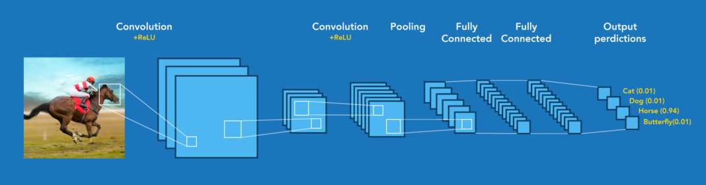
Image recognition structure:
The overall structure and sample output predictions of the image recognitions.

